Slide 1
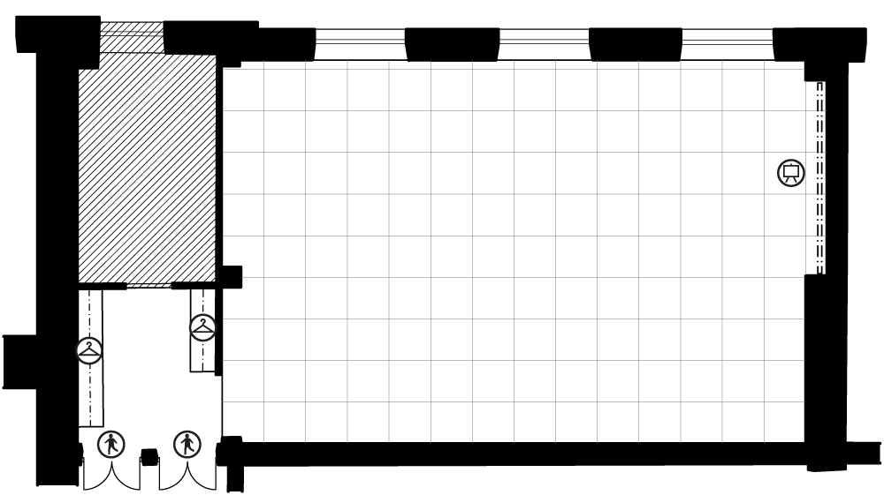
KARL LINDAHL 1 RUUTU / SQUARE = 1 m²

Slide 2
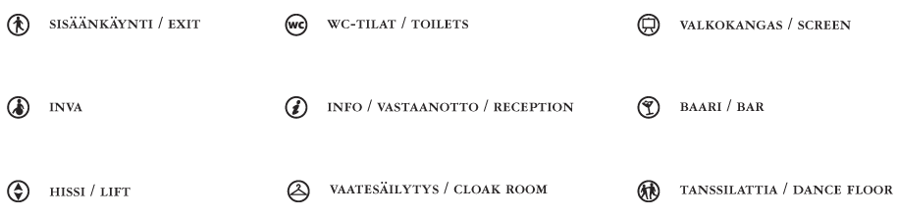
SYMBOLIT SYMBOLS

