Slide 1
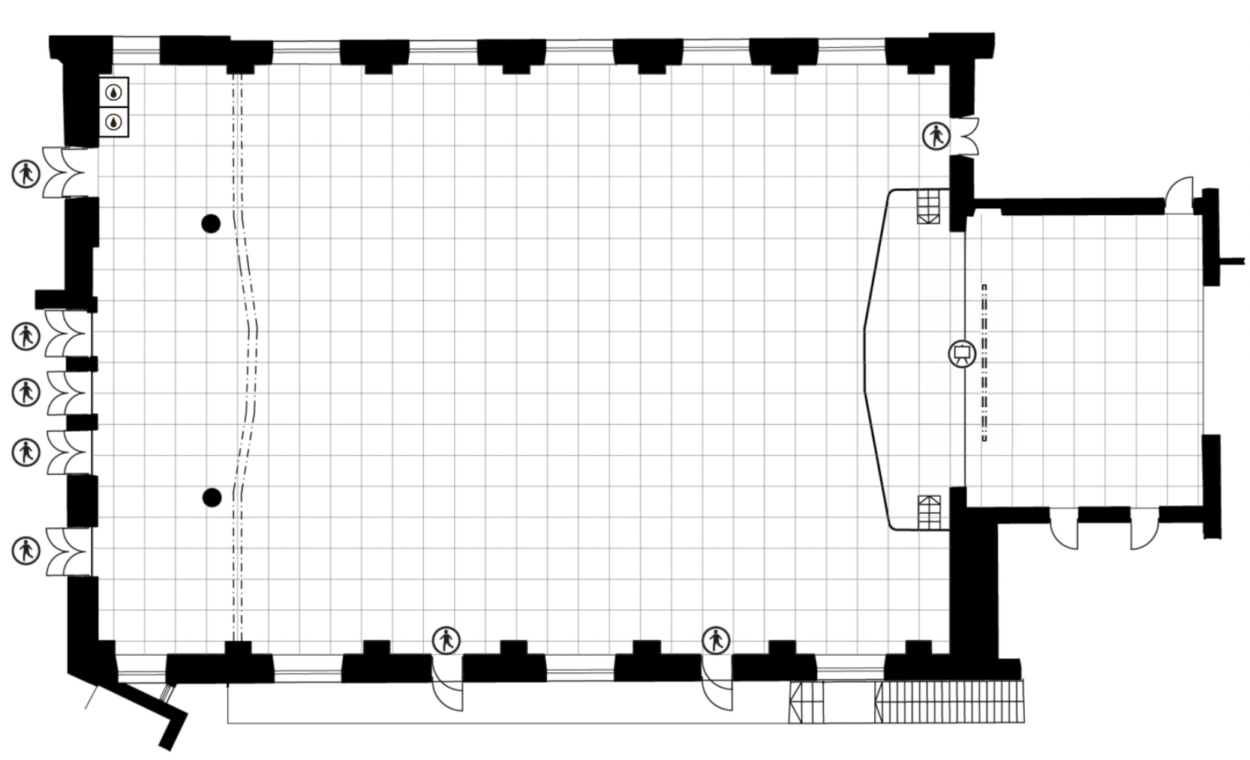
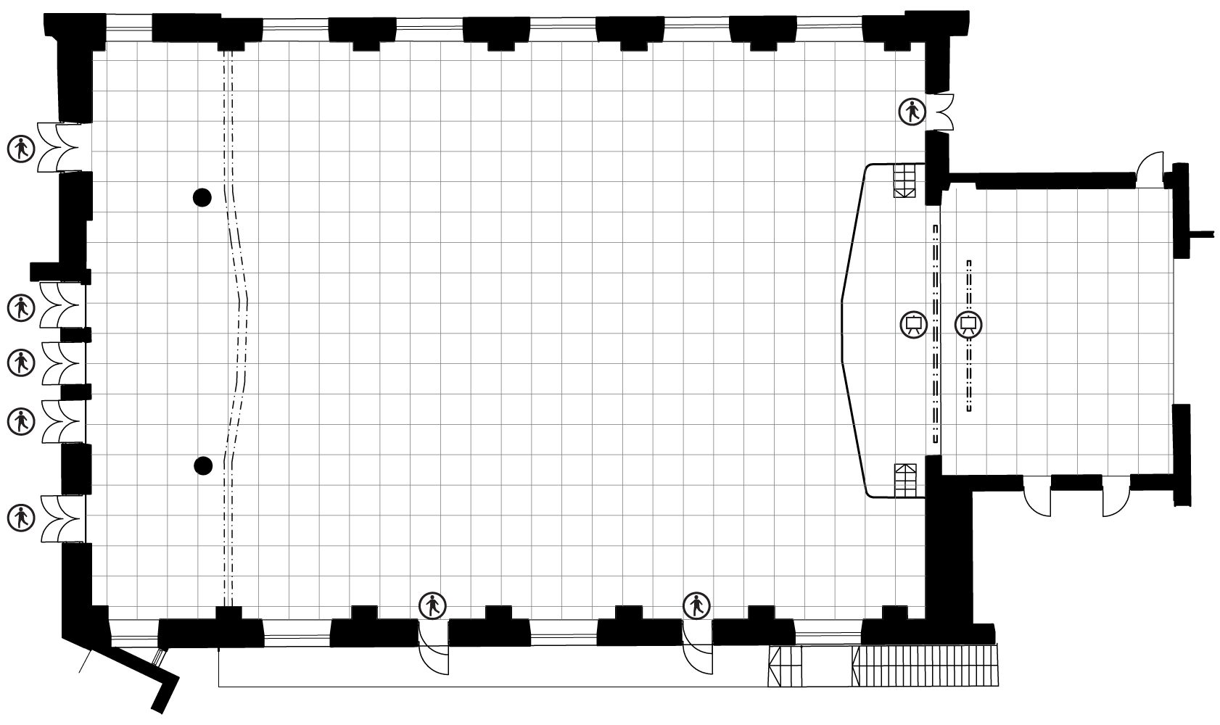
JUHLASALI / CONGRESS HALL 1 RUUTU / SQUARE = 1 m²

Slide 2
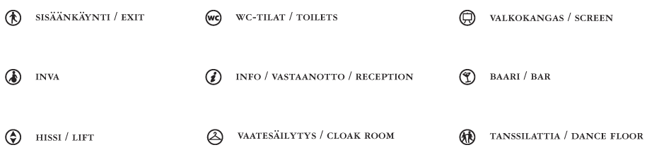
SYMBOLIT SYMBOLS

