Slide 1
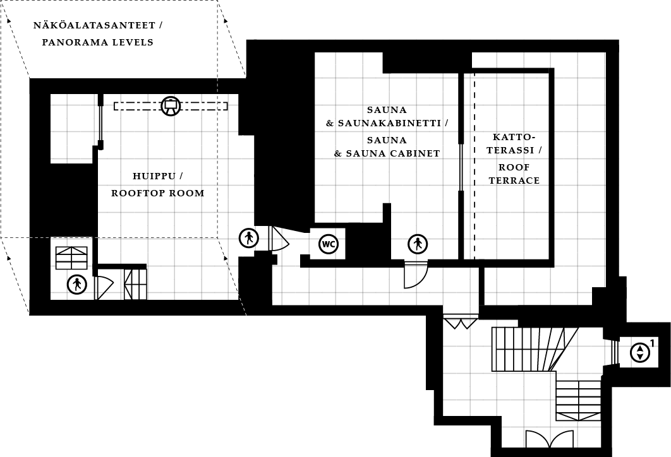
6. KERROS / FLOOR 6 1 RUUTU / SQUARE = 1 m²

