Slide 1
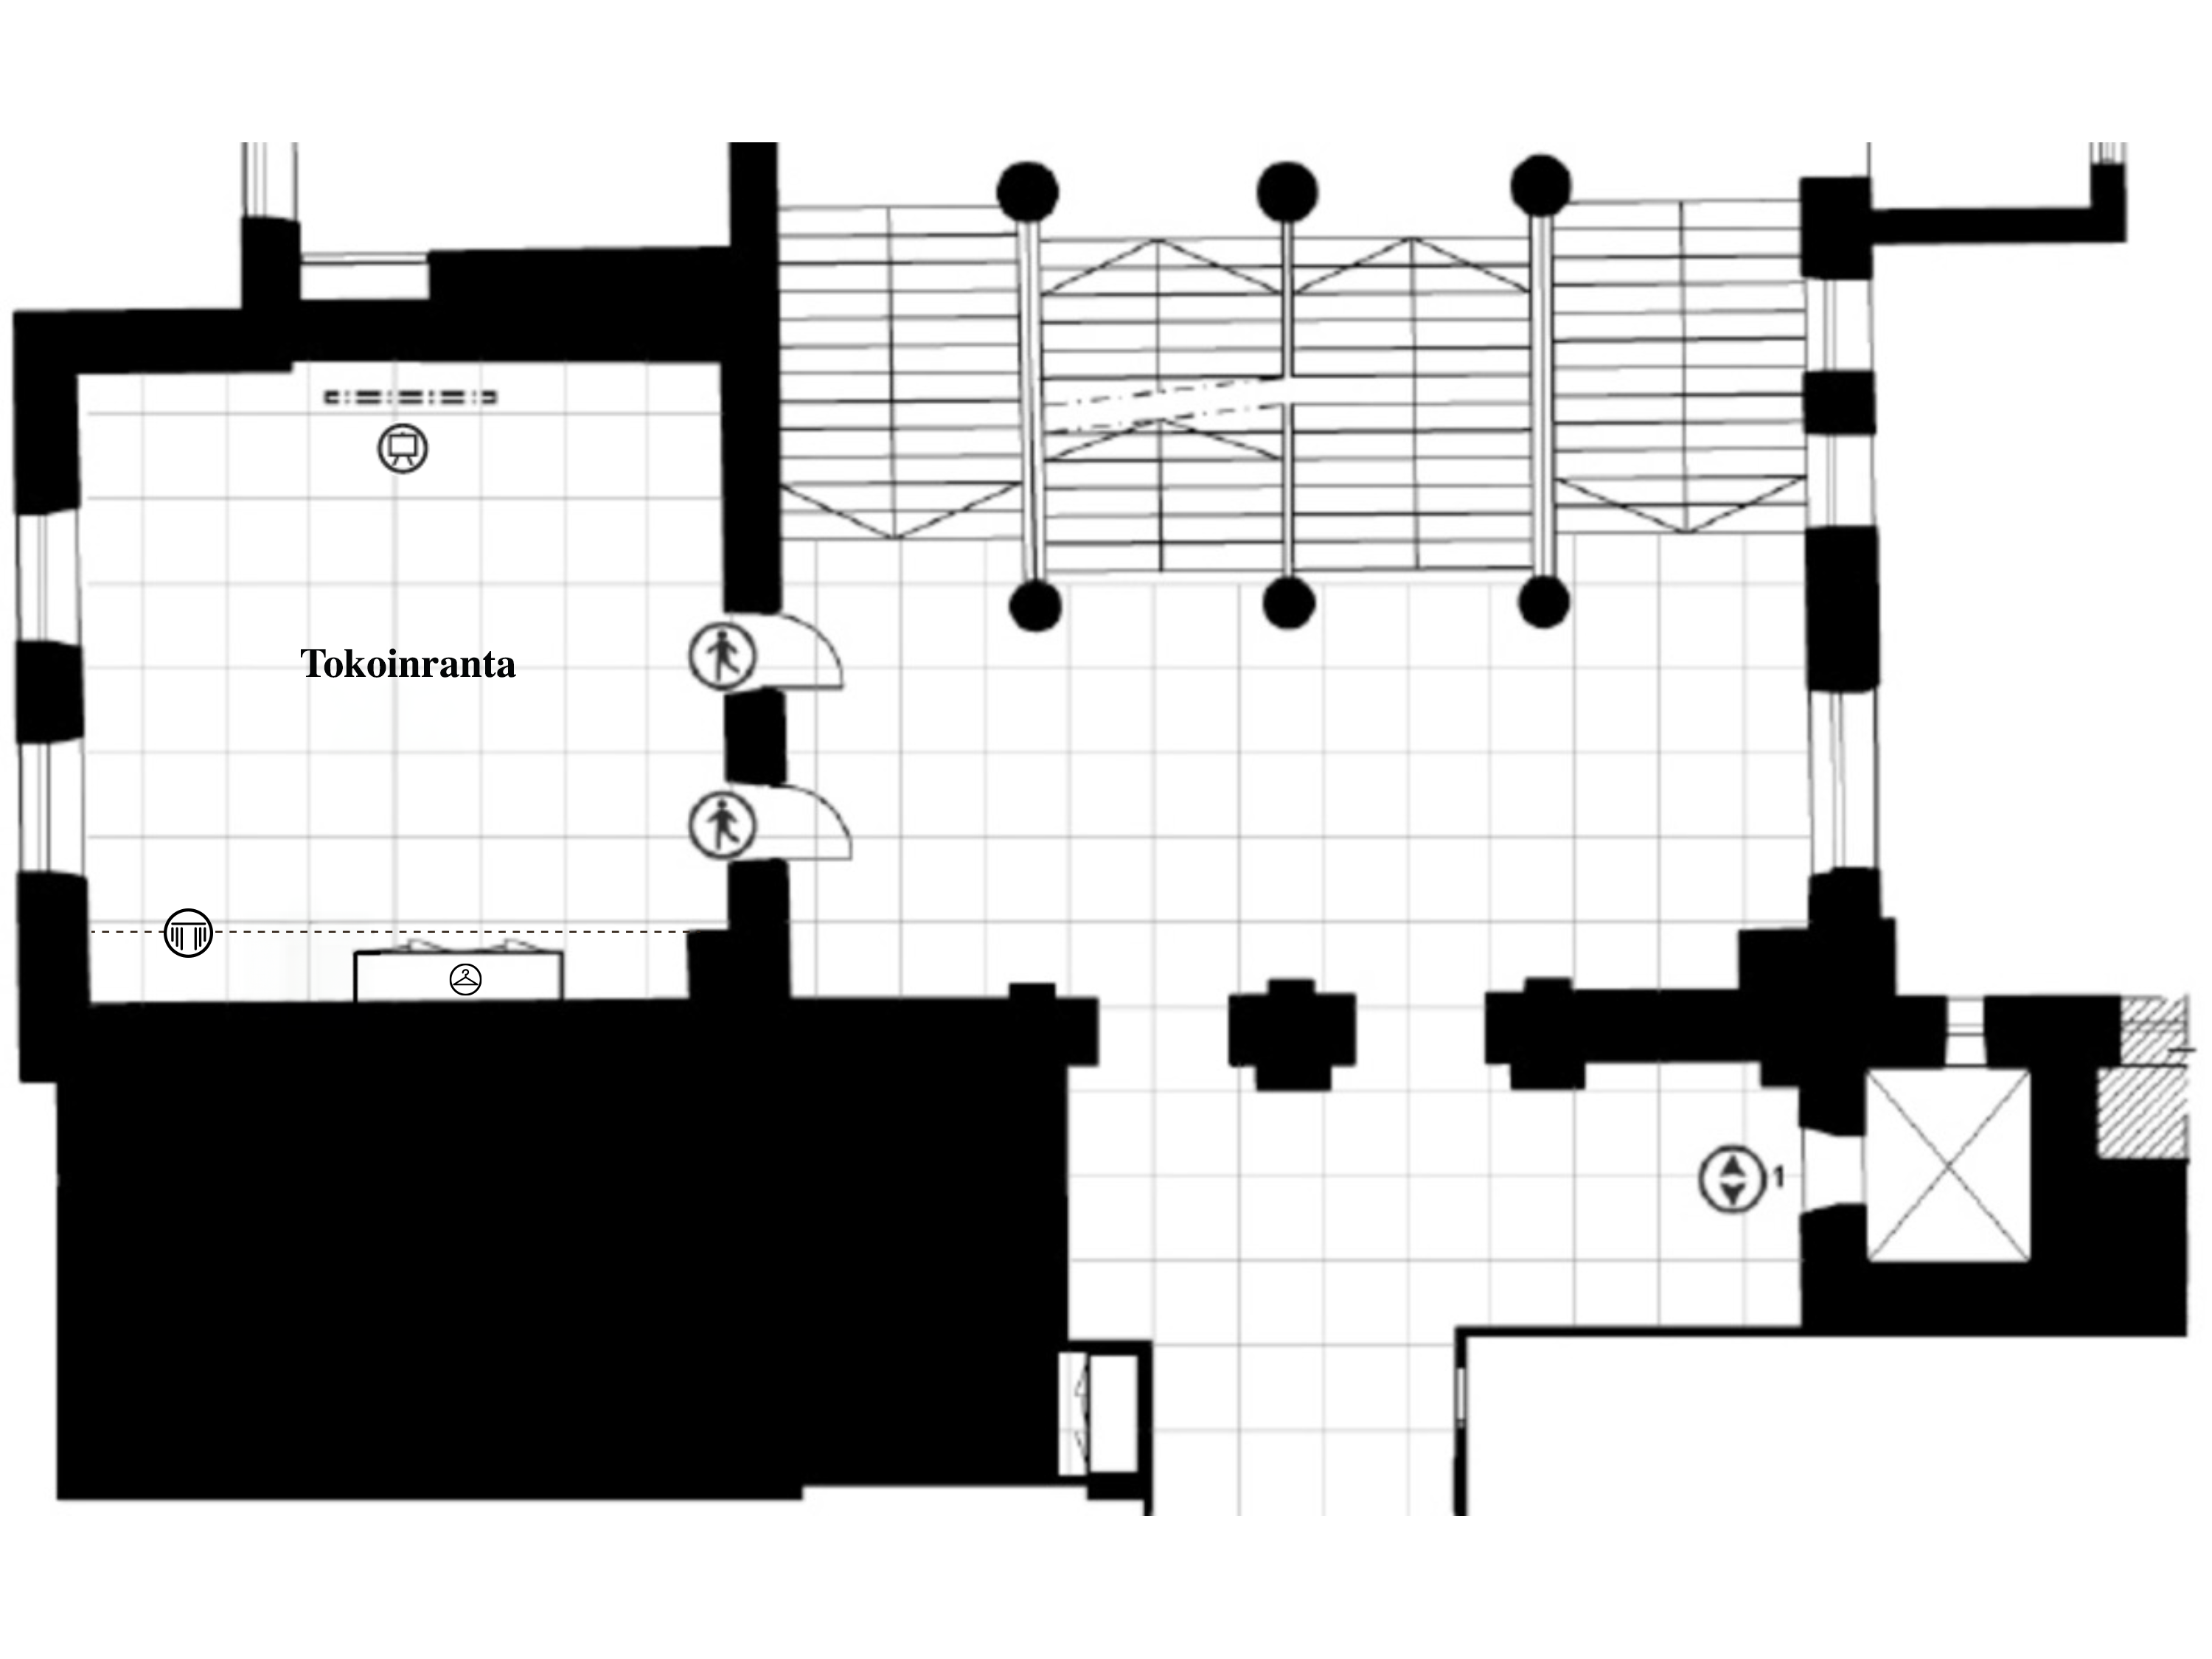
4. KERROS / FLOOR 4 1 RUUTU / SQUARE = 1 m²

Slide 2
