Slide 1
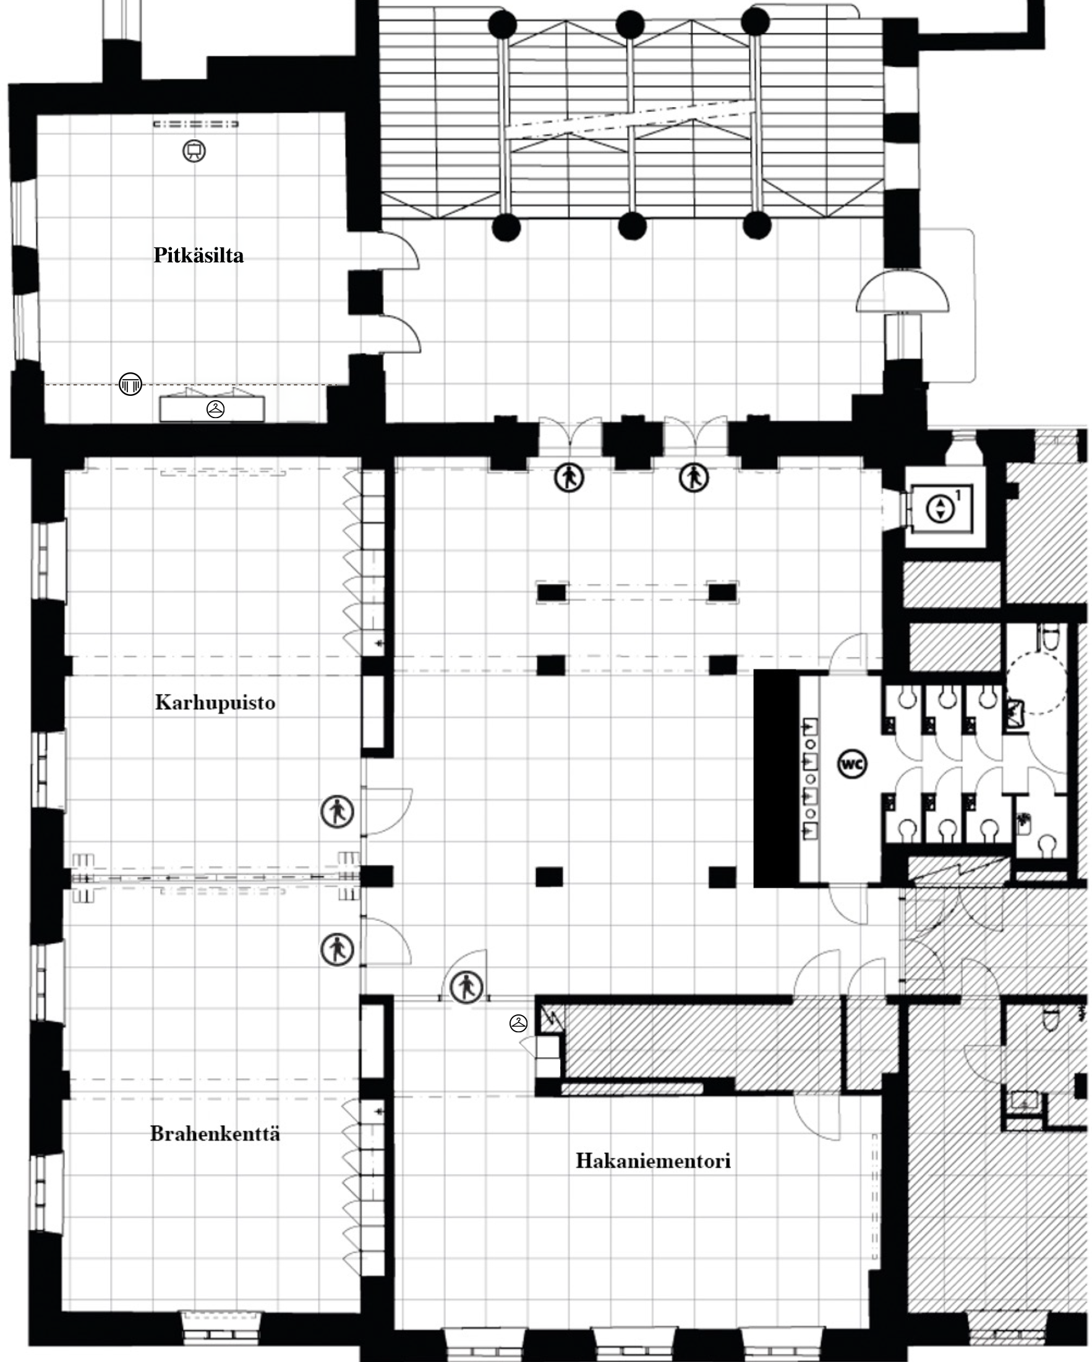
3. KERROS / FLOOR 3 1 RUUTU / SQUARE = 1 m²

Slide 2
