Slide 1
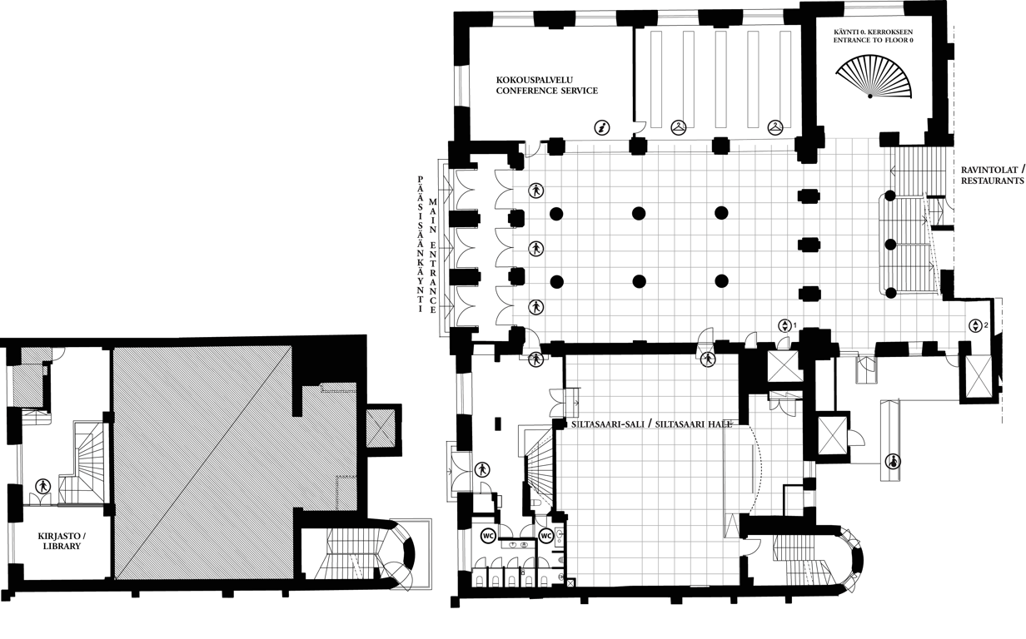
1. KERROS / FLOOR 1 1 RUUTU / SQUARE = 1 m²

Slide 2
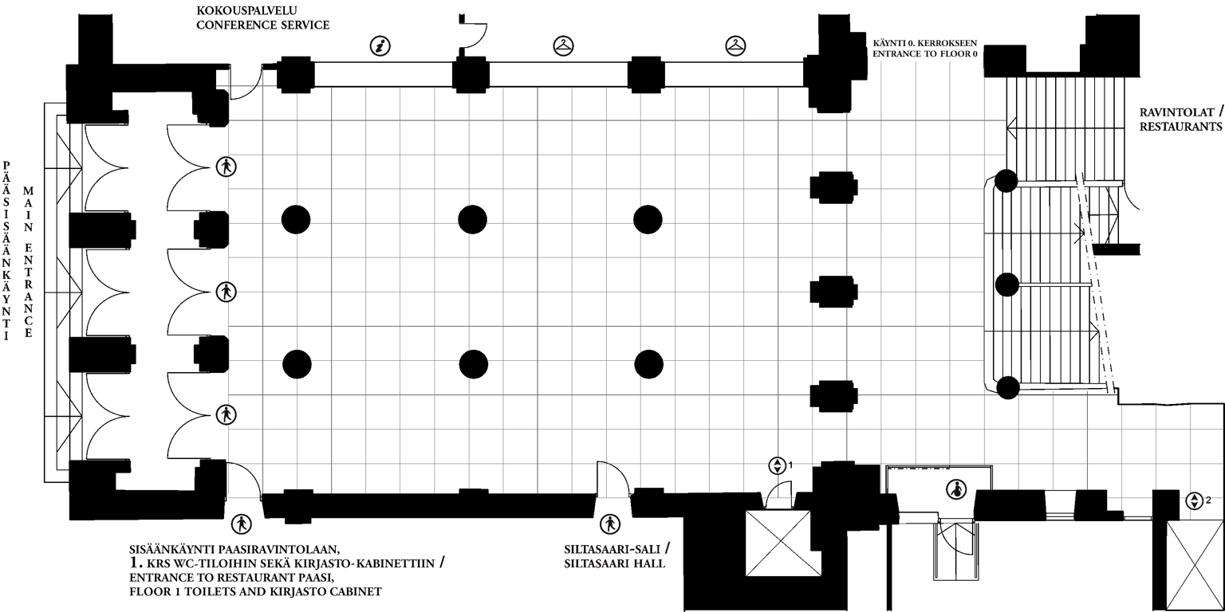
1. KERROS / FLOOR 1 1 RUUTU / SQUARE = 1 m²

Slide 3
