Slide 1
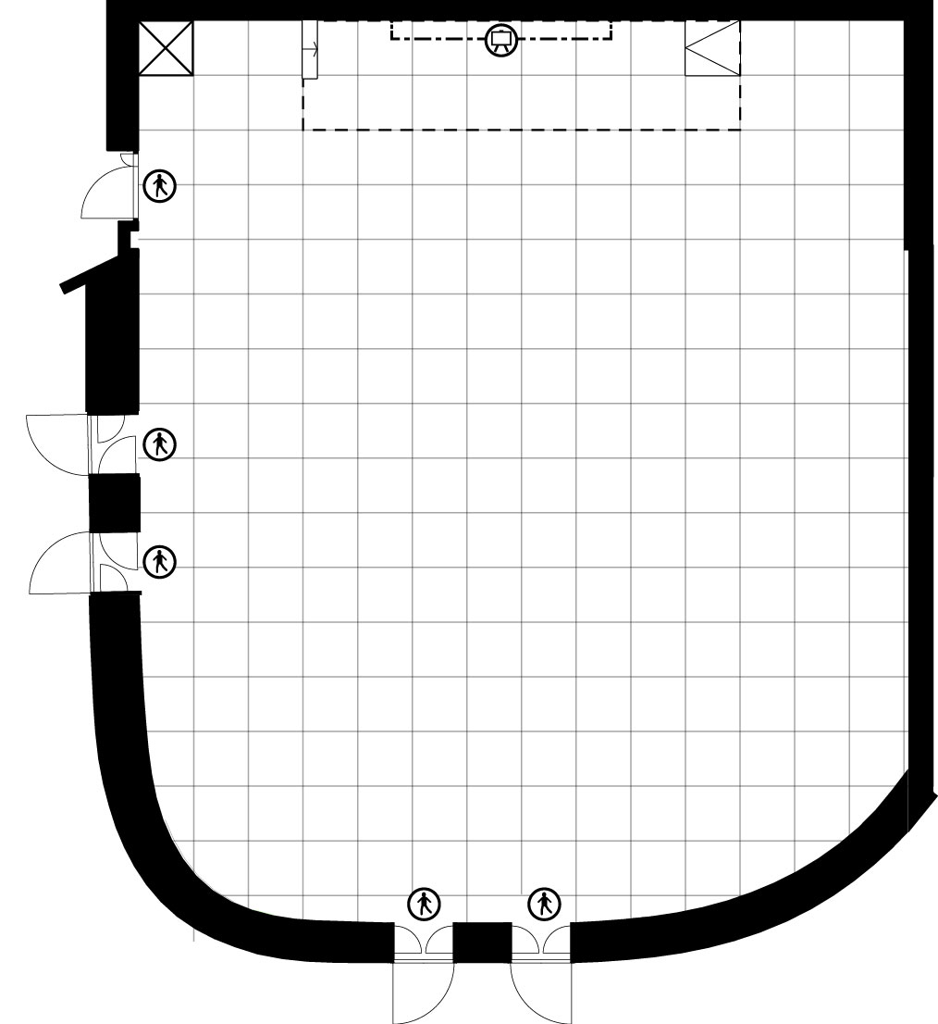
SIRKUS 1 RUUTU / SQUARE = 1 m²

Slide 2
SYMBOLIT SYMBOLS

